Slide 1
Exception Handling
Two most common types of bugs are logic errors and syntactic errors.
Exceptions are run time anomalies or unusual conditions that a program may encounter while executing.
Anomalies might include conditions such as division by zero, access to an array outside of its bounds.
When a program encounter an exceptional condition, it is important that it is identified and dealt with effectively.

Slide 2
Exception Handling
C++ provides a built-in error handling mechanism that is called exception handling.
C++ exception handling is built upon three keywords: try, catch, and throw.
In the most general terms, program statements that you want to monitor for exceptions are contained in a try block.
Any exception must be caught by a catch statement that immediately follows the try statement that throws the exception.

Slide 3
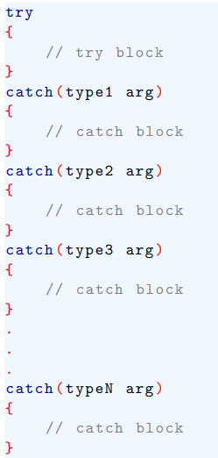
Exception Handling
The general form of try and catch are shown here:

Slide 4
Exception Handling
The catch statement that is used is determined by the type of the exception.
that is, if the data type specified by a catch matches that of the exception, that catch statement if executed (and all others are bypassed).
Any type of data can be caught, including classes that you create.

Slide 5

Exception Handling
The general form of the throw statement is shown here:
throw must be executed either from within the try block proper or from any function that the code within the block calls (directly or indirectly).
exception is the value thrown.

Slide 6
Exception Handling
If you throw an exception for which there is no applicable catch statement, an abnormal program termination might occur.
If your compiler compiles with Standard C++, throwing an unhandled exception causes the standard library function terminate() to be invoked.
By default, terminate() calls abort() to stop your program, but you can specify your own termination handler, if you like.

Slide 7
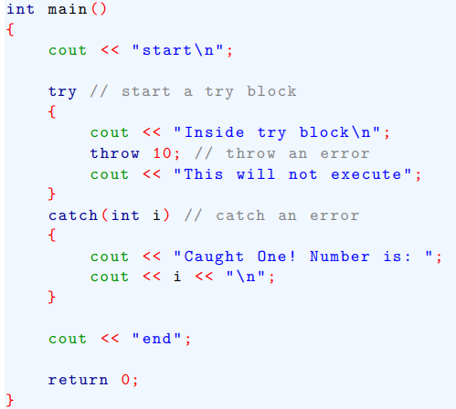
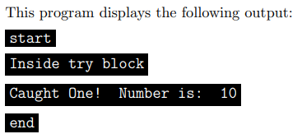
Exception Handling
Here is an example that shows the way C++ exception handling operates.

Slide 8
Exception Handling
As mentioned, the type of the exception must match the type specified in a catch statement.
For example, if you change the type in the catch statement to double, the exception will not be caught, and abnormal termination will occur. This change is shown here:

Slide 9
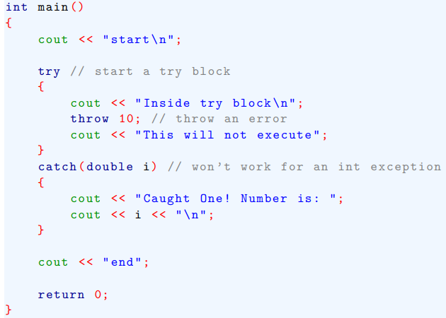
Exception Handling

Slide 10
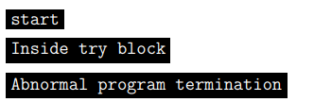
Exception Handling
this program produces the following output because the integer exception will not be caught by a double catch statement.

Slide 11
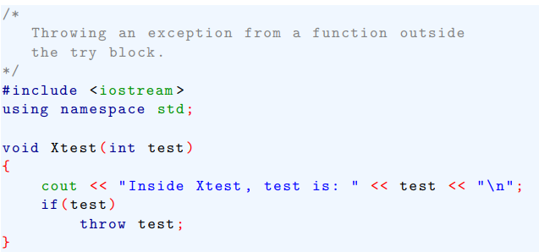
Exception Handling
An exception can be thrown from a statement that is outside the try block as long as the statement is within a function that is called from within the try block. For example, this is a valid program:

Slide 12
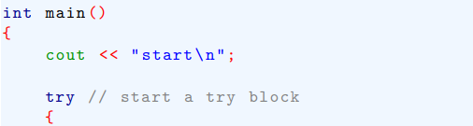
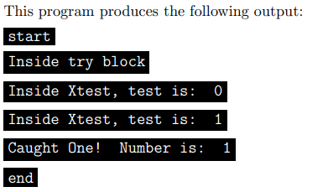
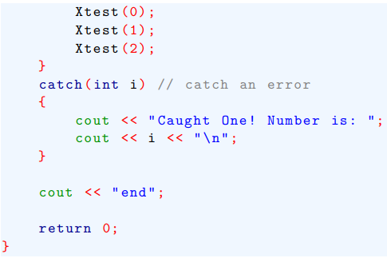
Exception Handling

Slide 13
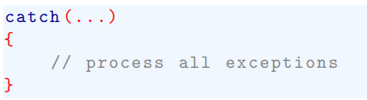
More about Exception Handling
In some circumstances you will want an exception handler to catch all exceptions instead of just a certain type.
This is easy to accomplish. Simply use this form of catch:

Slide 14
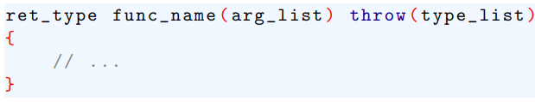
More about Exception Handling
you can restrict the type of exceptions that a function can throw back to its caller.
To apply these restrictions, you must add a throw clause to the function definition.
the general form of this is shown here:

Slide 15
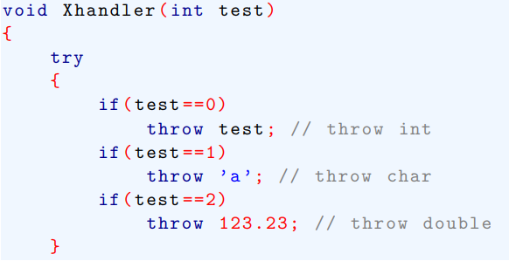
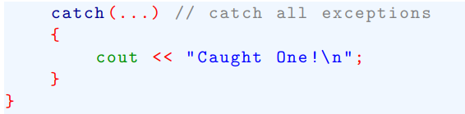
More about Exception Handling
The following program illustrates catch(...):

Slide 16
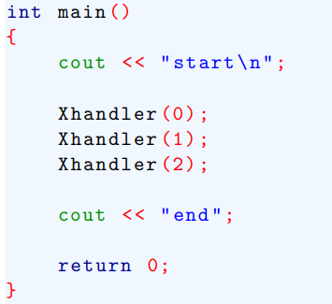
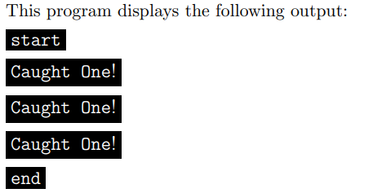
More about Exception Handling

Slide 17
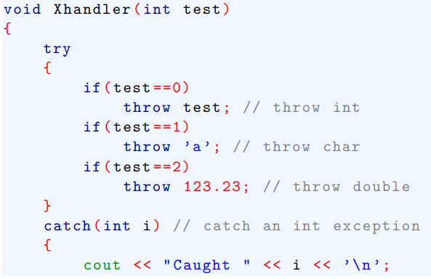
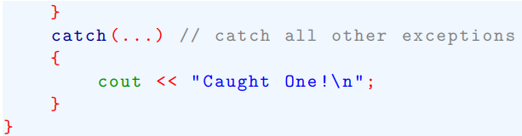
More about Exception Handling

Slide 18
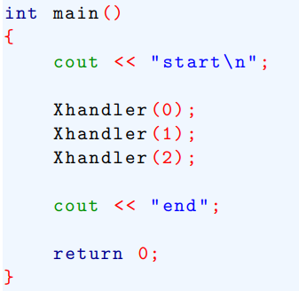
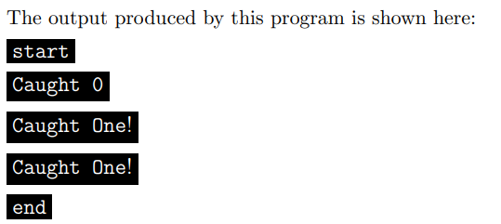
More about Exception Handling

Slide 19
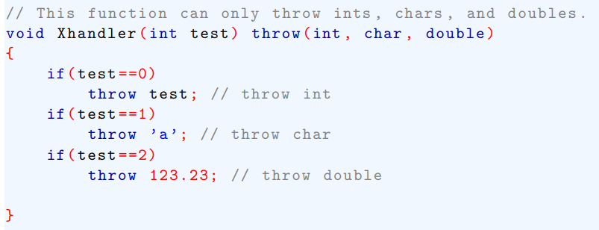
More about Exception Handling
The following program shows how to restrict the types of exceptions that can be thrown from a function:

Slide 20
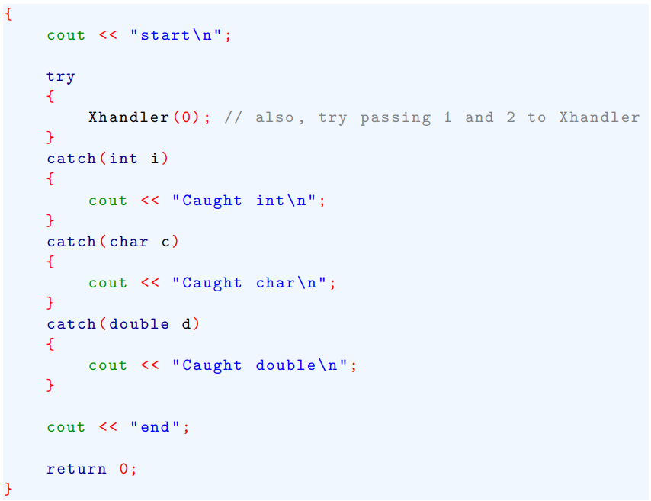
More about Exception Handling

